Slide 1

Algorithms that changed the world CA: Reed-Solomon algorithm
710050289

Slide 2
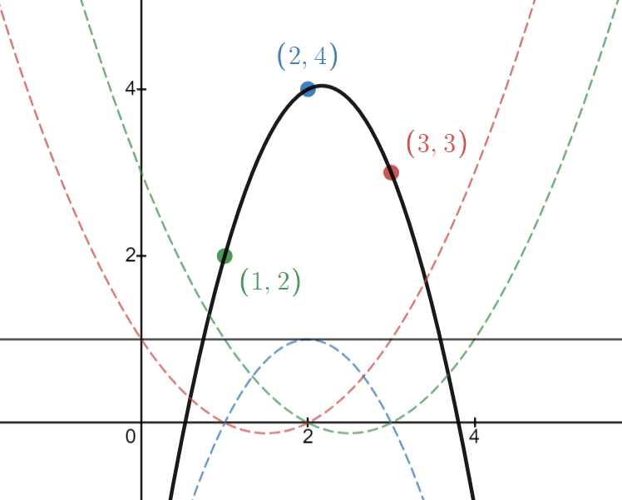
Paradigm
-Error-correcting code
-Lagrange interpolation theorem
-Generate unique polynomial based on message
-Character-based
-Burst-error correction
-Works under a Galois field (modulo arithmetic)

Slide 3
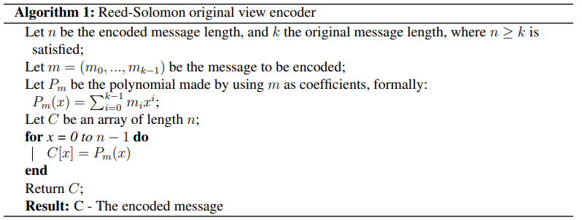
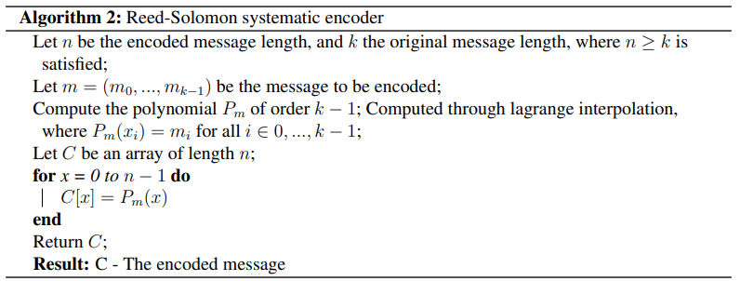
Encoding Procedure
O(n)

Slide 4
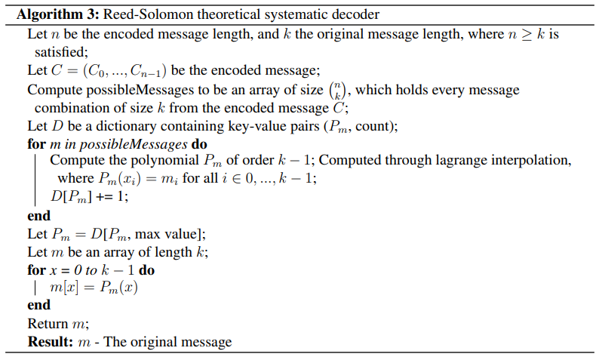
Decoding procedure
Counting most popular message polynomial
O(n choose k)

